Slide 1
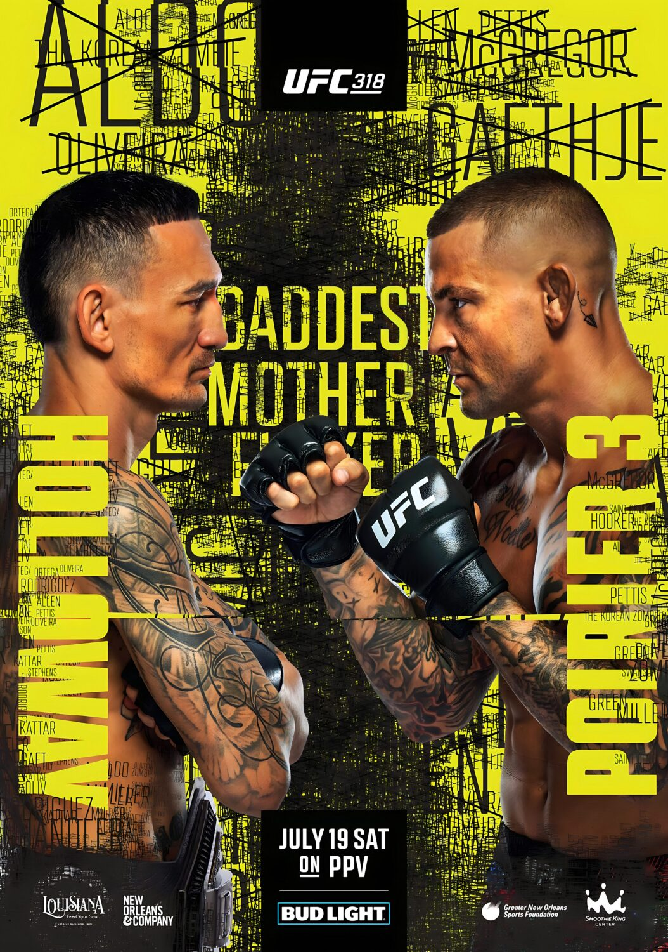
PREDICTING UFC FIGHT OUTCOMES WITH MACHINE LEARNING
ML MINI PROJECT · 2025–26 · FIGHT NIGHT EDITION
Main event: four algorithms step into the ring. One of them has to call the winner before the bell.
On the card: SGD · MLP · Decision Tree · Gradient Boosting
[Your name / team] · [Department]

Slide 2
PICK YOUR CORNER
ROUND 2 / 8
Given the tale of the tape for two UFC fighters, call the winner. This is a binary classification problem.
RED CORNER
BLUE CORNER
1
0
Red fighter wins (Class 1)
Blue fighter wins (Class 0)
Fight plan: compare four models fairly, judge them in time order, and put the winner on a web app.

Slide 3
TALE OF THE TAPE
ROUND 3 / 8
4,673
2010–21
26
1 / 0
fights after cleaning, from 6,012 raw rows
years of real UFC fights, newest from March 2021
stats compared between the corners, plus stance
result: Red wins or Blue wins
THE GAP: RED MINUS BLUE
Every stat is the gap between the corners, so it shows who has the edge.
Reach, age, wins, strikes landed, takedown accuracy, submission attempts, KO/TKO wins (diff_Reach_cms, diff_age, diff_wins, diff_avg_SIG_STR_landed, diff_avg_TD_pct, diff_avg_SUB_ATT, diff_win_by_KO/TKO)

Slide 4
THE RIGGED CARD
ROUND 4 / 8
Before 2010 the dataset lists Red as the winner in 1,229 of 1,244 fights (the other 15 were draws). The models were learning a recording quirk, not fighting.
98.8%
NaN
2010+
Red wins before 2010. Blue wins: zero.
CV scores for SGD and Gradient Boosting. The first fold was all Red.
The fix: drop earlier fights. 6,012 raw rows become 4,673 clean.
After cleaning, Red wins 58.85% and Blue 41.15%, a believable split.

Slide 5
THE FIGHT PLAN
ROUND 5 / 8
ROUND 1
ROUND 2
ROUND 3
ROUND 4
WEIGH-IN
FIGHT CARD
TALE OF THE TAPE
TRAINING CAMP
Drop draws and pre-2010 fights, set the winner label
Sort the fights by date
Engineer the Red minus Blue gaps
Older 80% (3,738) trains, newer 20% (935) is held out
ROUND 5
ROUND 6
ROUND 7
ROUND 8
WARM-UP
SPARRING
FIGHT NIGHT
PRESS CONFERENCE
Impute, scale and one-hot encode
Train 4 models with TimeSeriesSplit CV (k=5)
Evaluate on the held-out fights
Predict live in Streamlit
No peeking: time-ordered splits keep future fights out of training.

Slide 6
THE FIGHT CARD
ROUND 6 / 8
BOUT 1 · THE BOXER
MAIN EVENT · THE CHAMP
SGD CLASSIFIER
MLP
Straight lines only. Logistic regression trained by stochastic gradient descent, the linear baseline.
Hidden layers (64, 32) with ReLU, and early stopping so it doesn't gas out by overfitting. Best score on the test fights.
BOUT 3 · THE TACTICIAN
BOUT 4 · THE CONTENDER
DECISION TREE
GRADIENT BOOSTING
Sticks to a simple game plan: max depth 6, at least 10 samples per leaf.
100 trees, learning rate 0.1, depth 4. Each tree fixes the last one's mistakes.

Slide 7
THE SCORECARDS
ROUND 7 / 8
Judged on 935 held-out fights (Apr 2019 to Mar 2021). The baseline is a fighter who always picks Red.
Fighter | Accuracy | F1 | CV mean ± std
Always Red (baseline) | 59.68% | 44.61% | 58.27%
SGD Classifier | 54.44% | 54.86% | 55.54% ± 2.69
MLP | 62.35% | 60.57% | 59.94% ± 2.39
Decision Tree | 59.14% | 59.14% | 53.16% ± 2.26
Gradient Boosting | 59.89% | 58.58% | 58.72% ± 2.38
MLP beats the baseline by 2.67 points, Gradient Boosting by only 0.21, and SGD and Decision Tree fall short. With 935 fights, small gaps are close to noise.

Slide 8
POST-FIGHT
ROUND 8 / 8
LIVE FIGHT PREDICTOR
REMATCH PLAN
A Streamlit app: enter two fighters' stats and the trained models call the winner.
More fight footage: the full 3,000+ fight dataset
New fighters in camp: XGBoost, Random Forest, ensembles
Fine-tune the game plan: GridSearchCV or Optuna
Balance the card: SMOTE or class weighting
Fight-night feed: live data from UFCStats
THANK YOU. QUESTIONS?
Learning project only, not for betting.

